Slide 1

Credit Score Predictor : System that Predicts Customer Credit Scores based on Financial Data
Submitted by -
Group 35

Slide 2

Problem Statement
In the current financial landscape, credit scoring is crucial for financial institutions to assess the creditworthiness of potential customers. This project aims to develop a machine learning model that predicts the credit score of customers based on a comprehensive set of financial and behavioral data.
By leveraging this diverse set of features, the goal is to build a robust predictive model that provides accurate credit scores. This model will assist financial institutions in making informed decisions, reducing the risk of loan defaults, and offering tailored financial products to customers based on their risk profiles.
Standard

Slide 3

Need for machine learning to predict credit score
Manual assessment of creditworthiness is a time-consuming and resource-intensive process.
Processing and understanding these assessments becomes tedious task as the volume continues to increase.
Credit score assessments conducted manually are prone to subjectivity and bias.
Businesses that operate across various credit markets or have a wide range of clients face the challenge of scalability and adaptability in manual analysis.

Slide 4
Objectives
To save the time invested in calculating credit score of large set of customers manually
To migrate the data from on-premise database to Azure Data Lake Storage (ADLS) using Azure Data Factory (ADF) by creating ingestion pipeline
To clean the data using Data Flow in ADF and store it for further processing
To use big data framework for data cleaning and analysing
To perform feature engineering and extract relevant features
To build suitable machine learning model to predict credit score using spark ML
To make Credit Score Predictor function

Slide 5

Methodology
The whole framework of this project is divided into different parts, from initial data collection to the final deployment, as discussed below.
The data stored in mongodb is first migrated to ADLS in parquet file format using Azure Data Factory which will help in fast performance compared to other file format.
Big data platforms such as databricks were used to clean and analyze the data. Then the cleaned data was saved on databricks and further used for machine learning.
Multiple classification models were build and compared to select the best one for predicting credit score.
A user defined function was built that takes file as input and returns the bar chart og classification of credit score and csv file with Customer_Id and prediction column for user.

Slide 6






Architecture Design
deploy
Processing
Data
Source
Ingestion
Bronze
Silver
Gold
Transform

Slide 7
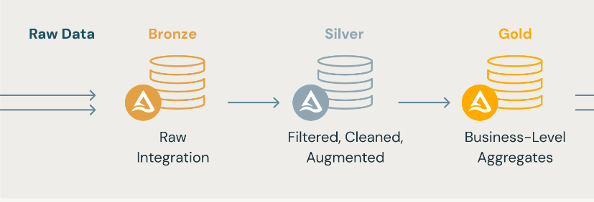
Medallion architecture is a design pattern commonly used in data processing and analytics to organize data into multiple layers for efficient processing and analytics.
Layered Structure:
Bronze Layer: Stores raw, unprocessed data from various sources.
Silver Layer: Cleans and structures data for intermediate processing.
Gold Layer: Provides refined, high-quality data for analysis and decision-making.
Medallion Architecture

Slide 8
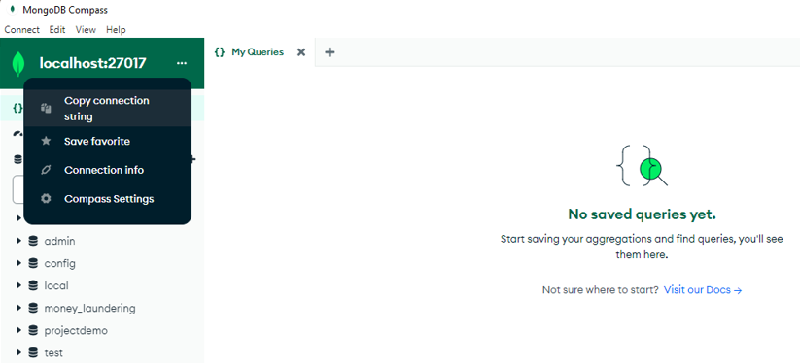
Data Ingestion
The first step involves transferring data from MongoDB to ADLS, specifically into the Bronze layer. This layer acts as the foundational storage for all raw data.
The data ingestion process is initiated by using the connection string provided by mongoDB on local machine and it was connected to the Azure cloud by Self-Hosted integration runtime and the key provided by ADF for connection.
Database : Bank_DB
Collection : credit_Score
mongodb://localhost:27017

Slide 9
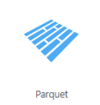
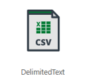
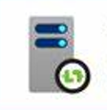
Self-Hosted Integration Runtime
SHIR is a component of Azure Data Factory (ADF) that enables secure data movement from on-premises data to the cloud.
It acts as a bridge between the MongoDB and Azure, ensuring that data is transferred without exposing it to the public internet. The runtime is installed on a local server, allowing ADF to securely access and move data to ADLS.
Site: Download Microsoft Integration Runtime from Official Microsoft Download Center

Slide 10
Data Cleaning - Stage 1
Data Flow for Cleaning:
Character Removal: The cleaning process targets specific unwanted characters such as :
values ending with (_)
values starting with (-)
exclamatory Marks (!)
blank spaces by (______)
Filtering and Validation: After the initial cleaning, the data is filtered to remove any remaining duplicates or irrelevant records

Slide 11

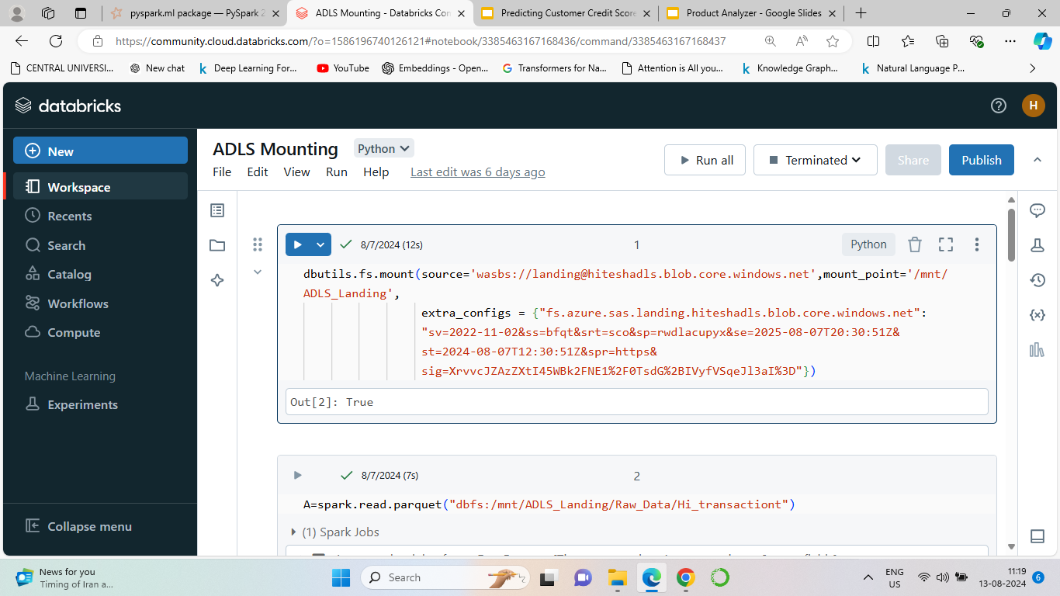
ADLS Mounting

Slide 12
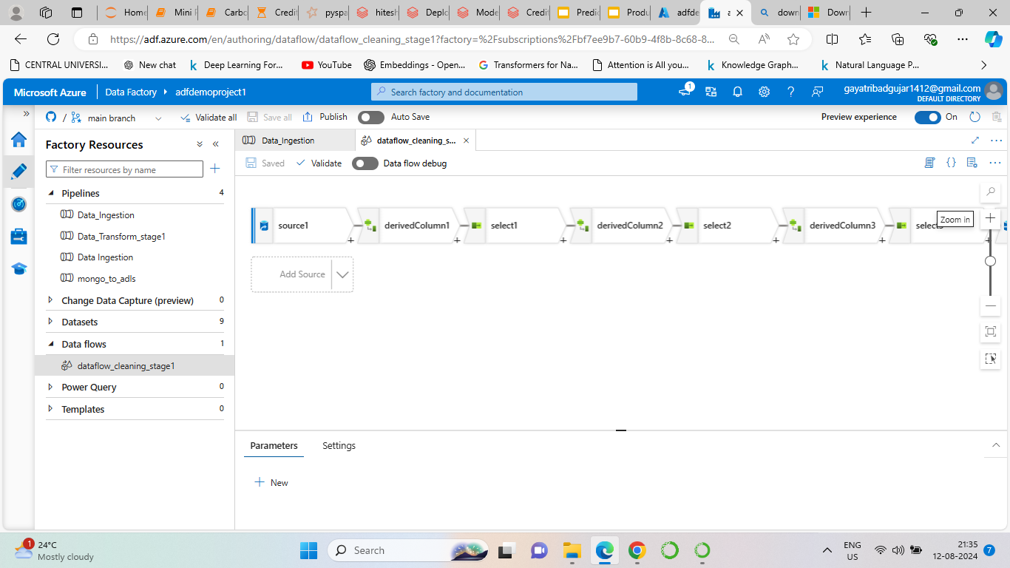

Slide 13
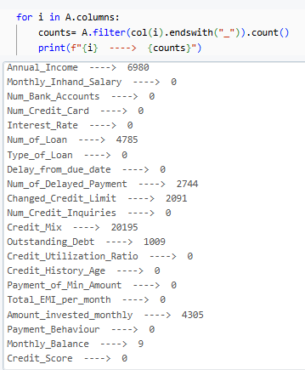
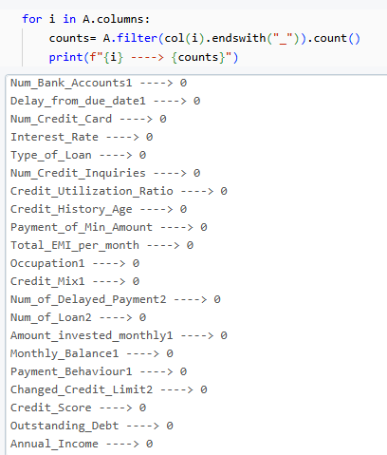
Before
After

Slide 14
Data Cleaning - Stage 2
Missing Data Treatment: Handled missing values by using imputation techniques to ensure completeness and accuracy of the dataset.
Outlier Removal: Identified and removed outliers that could distort analysis and impact model performance.
Skewness Check: Evaluated data skewness and applied transformations as needed to achieve a more normal distribution.
Data Storage: Saved the thoroughly cleaned and refined data in the Gold layer, ready for advanced analysis and modeling.

Slide 15
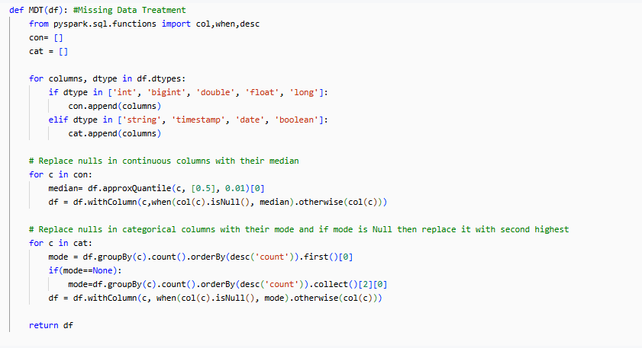
Missing Data Treatment
Input : DataFrame
Output : DataFrame

Slide 16
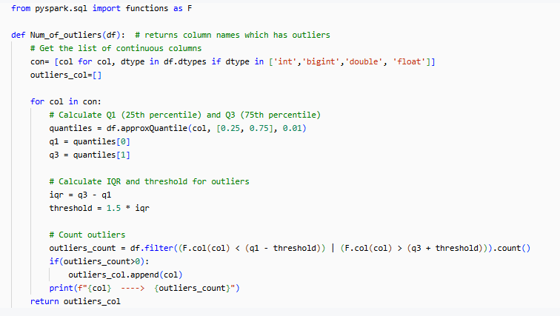
Removing Outliers
Detecting the columns which has outliers
Input : DataFrame
Output : Column List

Slide 17
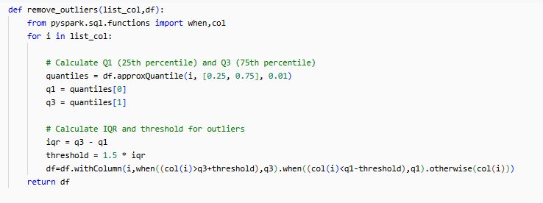
Removing Outliers from the data
Input : List, DataFrame
Output : DataFrame

Slide 18
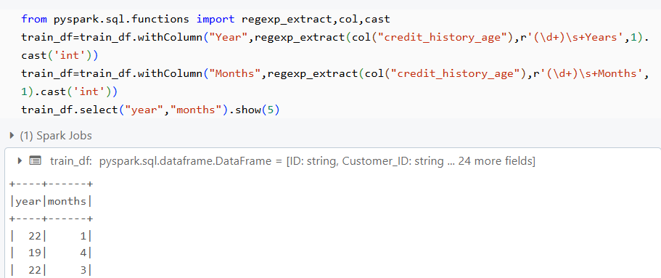
Machine Learning with Spark MLib
Feature Engineering:
Created and selected relevant features to enhance the predictive power of the model.
Extracting total year from credit_history_age column:

Slide 19
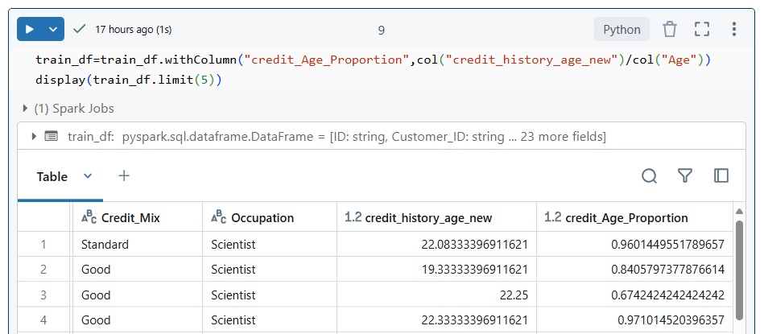
Credit_Age_Proportion
This feature indicates how long the customer has had credit relative to their age, which can influence their credit score. A higher proportion might indicate a more mature credit history.
Formula: Credit_Age_Proportion = Credit_History_Age_New / Age

Slide 20
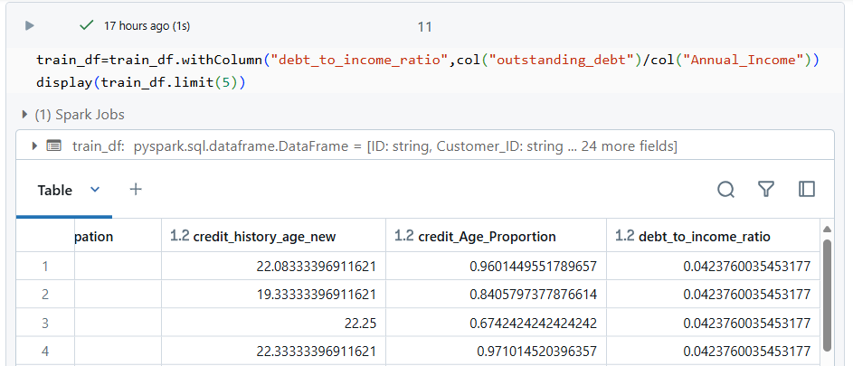
Debt_to_income_ratio
This ratio is a strong indicator of an individual's ability to manage debt relative to their income, which is critical for assessing creditworthiness.
Formula: Debt-to-Income Ratio = Outstanding_Debt / Annual_Income

Slide 21
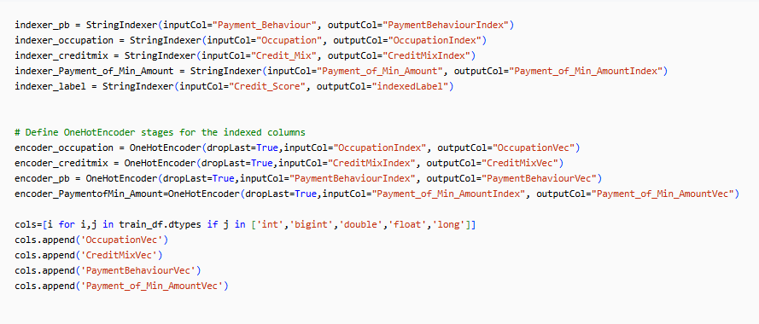
Preprocessing
One-Hot Encoding for categorical variables

Slide 22
Model Building
Standardization: Applied Min-Max Scaler to normalize feature values, ensuring consistent data ranges and improving model performance.
Model Evaluation: Tested multiple models to identify the best fit:
Logistic Regression: Evaluated for its effectiveness in binary classification tasks.
Support Vector Machine (SVM): Assessed for its ability to handle complex decision boundaries.
Random Forest: Used to capture non-linear relationships and improve prediction accuracy.

Slide 23
Random Forest
Random Forest is an ensemble learning method that combines multiple decision trees to make predictions. It leverages the wisdom of the crowd by aggregating the predictions of individual trees to produce a final prediction.It offers accuracy, robustness, and feature importance analysis, making it a powerful tool for various machine learning tasks.
Bootstrap
Aggregation
BAGGING
+
Why Random?
Random Sampling
Random Feature Selection
The final prediction of the Random Forest is made by aggregating the predictions (Soft Voting) of all individual decision trees. For classification tasks, the most common aggregation method is majority voting, where each tree's prediction is considered, and the majority class prediction is taken as the final prediction. For regression tasks, the predictions are averaged across the trees to obtain the final prediction.

Slide 24

……..
random_state= r1
random_state= r2
random_state= r3
random_state= rn
Y ~ X1,X2
Y ~ X3,X4
Y ~ X5,X8,X10
Y ~ X1,X8,X4,X6,X7
P1
P2
P3
Pn
P
(Final Prediction)

Slide 25
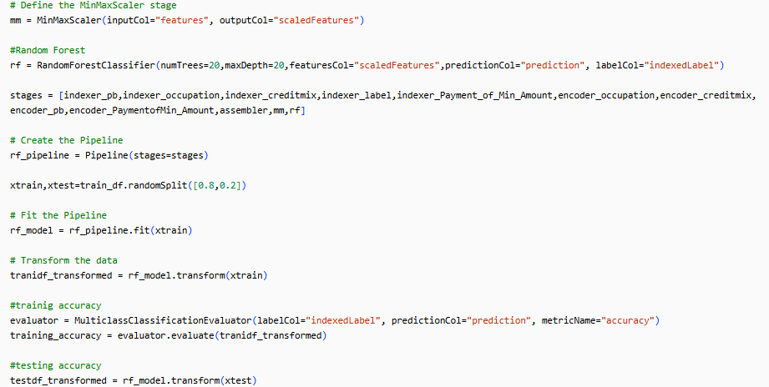
Created pipeline with stages to perform random forest classification

Slide 26
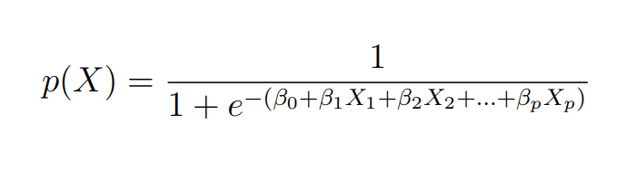
Logistic Regression
Logistic regression estimates the probability of an instance belonging to a specific class. It uses a logistic or sigmoid function to map the linear combination of input features to a value between 0 and 1. The logistic function ensures that the predicted probabilities are within this range, allowing us to interpret them as the likelihood of an instance belonging to a particular class.

Slide 27
Support Vector Machine
Support Vector Machine (SVM) Classifier, is a powerful supervised learning algorithm used for classification tasks. It is based on the concept of finding an optimal hyperplane that separates the data into different classes. SVC works by identifying support vectors, which are the instances that lie closest to the decision boundary.
Linear Boundary:
In the case of linearly separable data, SVC aims to find a hyperplane that separates the instances with the maximum margin. This hyperplane should have the largest distance between the support vectors of different classes.
Non-Linear Boundary:
In situations where the classes are not linearly separable, SVC utilizes the kernel trick. It maps the input features to a higher-dimensional space where a linear separation becomes possible. This allows SVC to handle non-linear classification problems.

Slide 28
Once the hyperplane is determined during the training phase, SVC can make predictions for new, unlabeled instances
Margin and Threshold: The distance of an instance from the hyperplane determines its predicted class. If an instance falls within the margin region or on the correct side of the hyperplane, it is classified accordingly. If an instance crosses the threshold, it is classified as belonging to the other class.
Margin =m1+m2
m1
m2

Slide 29
Result
Algorithm | Training Accuracy | Testing Accuracy
Logistic Regression | 0.6423 | 0.646
Support Vector Classifier | 0.617 | 0.616
Random Forest Classifier | 0.936 | 0.896
Recall
0.646
0.616
0.896

Slide 30
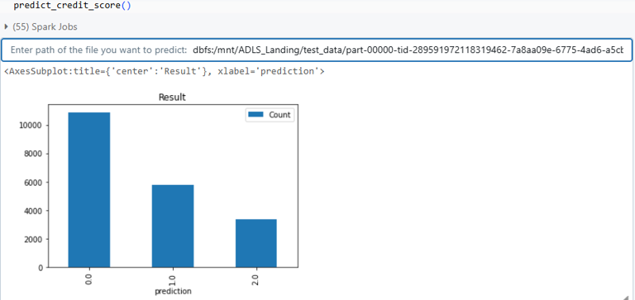
Credit Score Predictor
0 - Standard
1 - Poor
2 - Good
Input : Path to file
Output : CSV file, Bar Plot

Slide 31
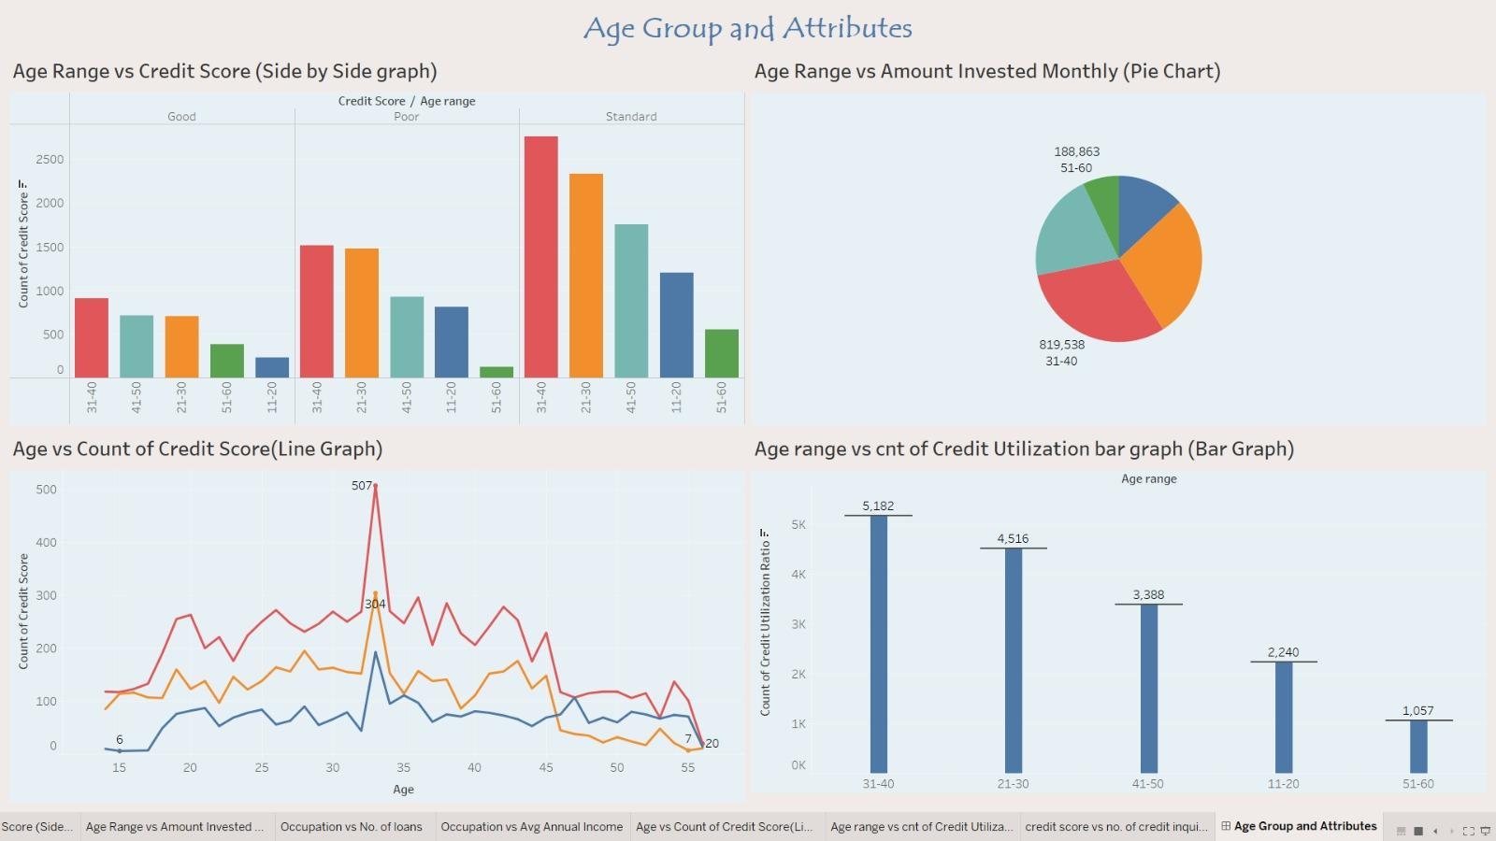
Tableau
https://public.tableau.com/views/CreditScore_17235405423970/AgeGroupandAttributes?:language=en-US&:sid=&:redirect=auth&:display_count=n&:origin=viz_share_link

Slide 32
Conclusion
Comprehensive Data Pipeline: Implemented a robust data pipeline using Medallion architecture to efficiently handle data from raw ingestion to final processing.
Effective Data Cleaning: Utilized advanced techniques in the Gold layer to ensure high-quality data, including handling missing values, outlier removal, and skewness adjustment.
Advanced Machine Learning: Applied PySpark for feature engineering, data standardization, and model evaluation, testing Logistic Regression, Support Vector Machine, and Random Forest to identify the best-performing model.
Credit Score Predictor was built which takes path of file as input and returns a file with predictions and a bar plot visualizing the count of credit score labels.
Future Deployment: Planned deployment using Streamlit to create a user-friendly interface for real-time credit score prediction.

Slide 33
THANK YOU

